Slide 1
RSM222
Management Accounting 1
Class 5: Costing Systems – ABC Costing
Elisa Zuliani

Slide 2
Learning Objectives of Class 5
Explain the activity-based costing model and how it differs from a traditional costing system.
Assign costs to cost pools using a first-stage allocation, and compute activity rates.
Assign costs to a cost object using a second-stage allocation.
Use activity-based costing to compute product and customer margins.
Compare product costs computed using traditional and activity-based
costing methods.
Understand the benefits and limitations of ABC

Slide 3
Product Costing
ABC Costing

Slide 4
Costing Methods Overview
Costing Methods
Costing methods are used to assign a cost to a manufactured product.
Absorption Costing
Job-Order
Absorption Costing
Process
Activity Based Costing (ABC
Variable Costing
Gross
Margin
Gross
Margin
Classify costs based on judgment and decision at hand
There are no specific rules to classification
Uses multiple cost pools
Find the best driver (allocation base) for each cost pool
Contribution
Margin
Classify costs between product and period costs
OH rate used to allocate indirect costs
Accepted under ASPE and IFRS
Unit costs are computed by department
Products in a process costing environment in sequence from one department to another
Classify costs between variable and fixed costs
Class 3
Class 4
Class 5
Class 6

Slide 5
Traditional Costing Systems
Product Costs
Direct labor
Direct materials
Factory Overhead
Appear on the income statement when goods are sold, prior to that time they are stored on the balance sheet as inventory.
Period Costs
Administrative Expenses
Sales Expenses
Appear on the income statement in
the period incurred.
Issue? → Is OH allocation appropriate? Are non-manufacturing costs not
important to cost of products?

Slide 6







Problem with Traditional (ie. Absorption Costing)
All products consist of material, labor, and overhead, and the major cost components have historically been materials and labor.
  As technology changes the ratio between direct labor and overhead, more overhead costs are linked to drivers other than direct labor and machine hours.
  For many companies, and in many cases, overhead costs are now significantly larger than labor costs

Slide 7
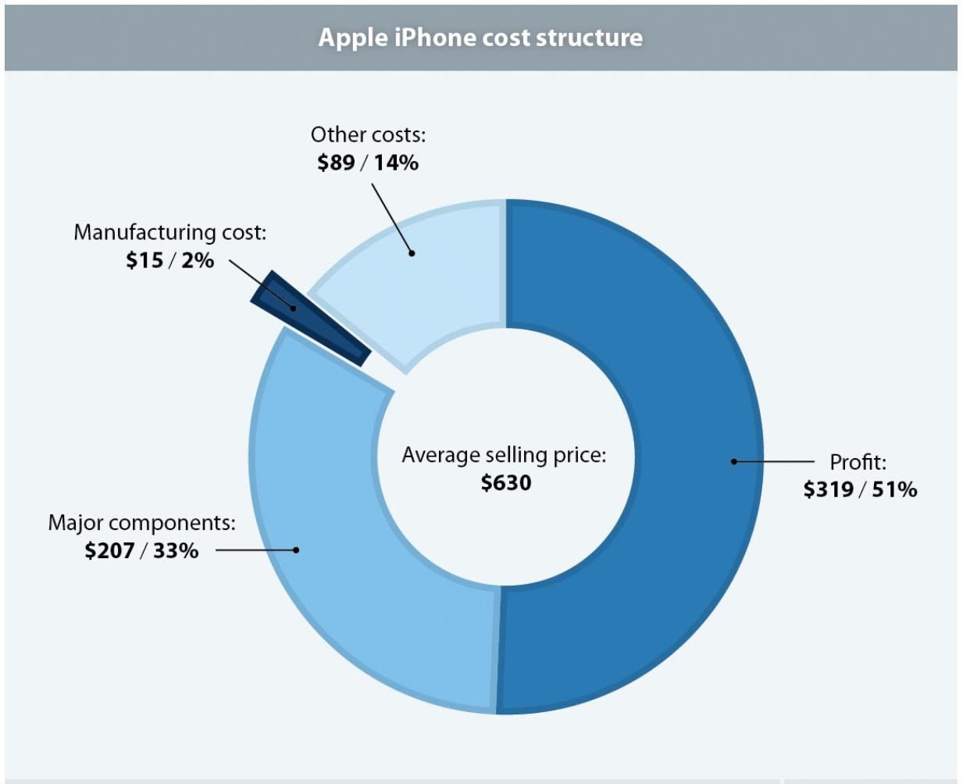
Problem with Traditional (ie. Absorption Costing)
Note: This is from 2011. We could all tell by the avg. selling price…
Would direct labor and machine hours best approximate the OH costs ?
Source: https://www.epi.org/blog/apple-iphone-profits-dwarf-labor-costs/

Slide 8
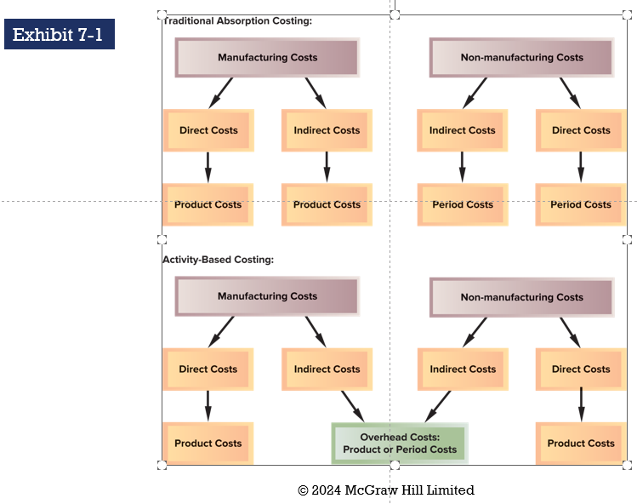
Difference between Traditional & ABC

Slide 9
Overhead Cost Pools, Allocatinon Bases & ABC
ABC uses more cost pools and unique measures of activity to better understand the costs of managing and sustaining product diversity.
Activity
An event that causes the consumption of overhead resources.
Activity Cost Pool
A “cost bucket” in which costs related to a particular activity measure are accumulated.
Activity Measure
An allocation base in an ABC system, also called a cost driver. Two common types are transaction drivers and duration drivers
7-9

Slide 10
Overhead Costs Pools, Allocation Bases & ABC
Two common types of activity measures:
Transaction
driver
Duration
driver
Simple count
of the number of
times an activity
occurs.
A measure
of the amount
of time needed
for an activity.
7-10

Slide 11
Overhead cost Pools, Allocation Bases & ABC
ABC defines
five levels of activity
that largely do not relate
to the volume of units
produced.
Traditional cost systems usually rely on volume
measures such as direct labour hours and/or machine
hours to allocate all overhead costs to products.
7-11

Slide 12
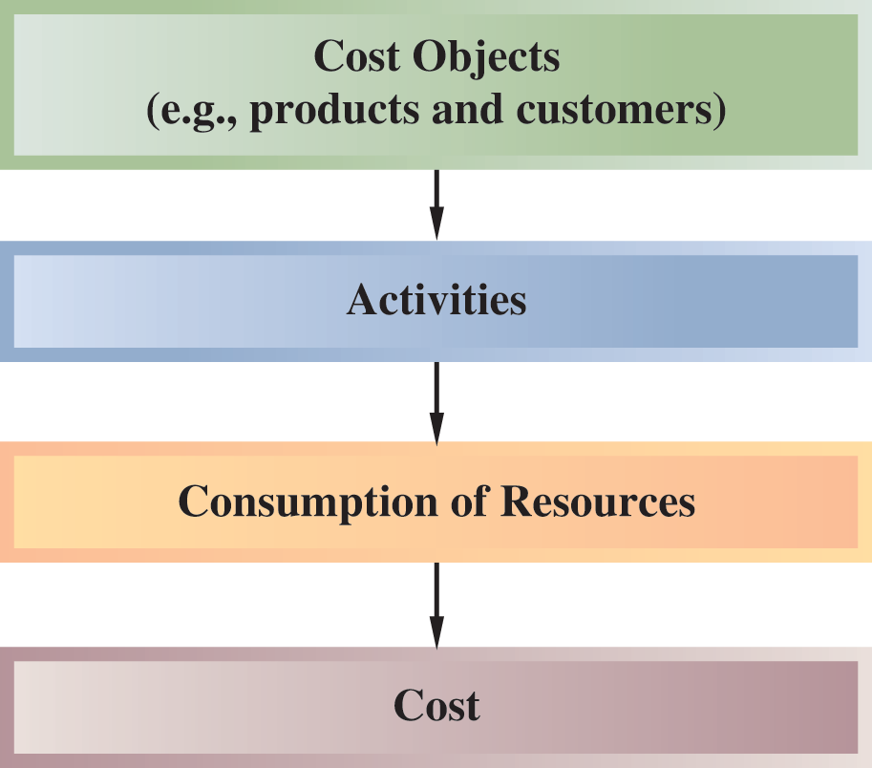
Designing an ABC System
Exhibit 7-3
7-12

Slide 13
Steps for Implementing ABC:
Identify and define activities, activity cost pools and activity measures.
Assign overhead costs to activity cost pools.
Calculate activity rates.
Assign overhead costs to cost objects using the activity rates and activity measures.
Prepare management reports.
7-13

Slide 14
ABC Example
Musicality Manufacturing developed a recording device that allows musicians to record their playing or singing along with any song publicly available.
  There are three products that vary in features and ability:
    Solo
    Band
    Orchestra
  Direct Costs are shown below:
 | Solo | Band | Orchestra
DM | $3.50 | $6.00 | $11.70
DL | $10.00 | $2.75 | $4.30

Slide 15
ABC Example – Traditional Method
Musicality determines the overhead rate based on direct labor hours. At the beginning of the year, the company estimates:
  Total overhead costs: $2,500,000
  Total direct labor hours: 1,250,000
POHR =
POHR =
POHR =
Estimated OH/ Estimated Units of Cost Driver
$2,500,000/ 1,250,000
$2 per Direct Labor Hour

Slide 16
ABC Example – Traditional Method
 | Solo | Band | Orchestra | Total
DL per Product | 350,000 | 400,000 | 500,000 | 1,250,000
POHR | * $2 | * $2 | * $2 | * $2
OH Assigned | $700,000 | $800,000 | $1,000,000 | $2,500,000
# of Units | 140,000 | 100,000 | 250,000 | 490,000
OH per unit | $5 | $8 | $4
DM | $3.50 | $6.00 | $11.70
DL | $10.00 | $2.75 | $4.30
Cost per Unit | $18.50 | $16.75 | $20.00

Slide 17
ABC Example – ABC Method
Musicality believes the following activities are necessary to complete production:
Activity | Cost Driver | Estimated Costs | Total Activity | ABC Rate
1. Setting up machines | Machine Setups | $200,000 | 5,000 | $40
2. Purchasing material | # of Purchase Requisitions | $500,000 | 10,000 | $50
3. Inspecting products | Inspection Hours | $300,000 | 20,000 | $15
4. Assembling products | # of Parts Requiring labor | $600,000 | 30,000 | $20
5. Technological Production | Machine Hours | $900,000 | 150,000 | $6
TOTAL |  | $2,500,000
Notice Anything Similar? Is the ABC Rate not just a collection of POHR?

Slide 18
ABC Example – ABC Method
Musicality determined the driver and est. activity for each product to be:
Cost Driver | ABC Rate | Solo | Solo OH Cost | Band | Band OH Cost | Orchestra | Orchestra OH Cost
Machine Setups | $40 | 2,000 | $80,000 | 1,500 | $60,000 | 1,500 | $60,000
# of Purchase Requisitions | $50 | 5,000 | $250,000 | 4,000 | $200,000 | 1,000 | $50,000
Inspection Hours | $15 | 10,000 | $150,000 | 9,000 | $135,000 | 1,000 | $15,000
# of Parts Requiring labor | $20 | 15,000 | $300,000 | 3,000 | $60,000 | 12,000 | $240,000
Machine Hours | $6 | 80,000 | $480,000 | 60,000 | $360,000 | 10,000 | $60,000
TOTAL |  |  | $1,260,000 |  | $815,000 |  | $425,000
# of Units |  |  | 140,000 |  | 100,000 |  | 250,000
OH per unit |  |  | $9 |  | $8.15 |  | $1.70

Slide 19
ABC Example - Comparison
Would the difference not impact decisions??
Traditional | Solo | Band | Orchestra
OH per unit | $5 | $8 | $4
DM | $3.50 | $6.00 | $11.70
DL | $10.00 | $2.75 | $4.30
Cost per Unit | $18.50 | $16.75 | $20.00
Which is more accurate?
ABC | Solo | Band | Orchestra
OH per unit | $9 | $8.15 | $1.70
DM | $3.50 | $6.00 | $11.70
DL | $10.00 | $2.75 | $4.30
Cost per Unit | $22.50 | $16.90 | $17.70

Slide 20
What is Activity Based Costing (ABC)?
Traditional costing is the allocation of factory overhead to products based on the volume of production resources consumed
  Allocates costs based on a single volume measure, such as direct labour hours or
machine hours.
  Does not consider that certain products may be responsible for more or fewer costs from specific activities.
Activity-Based Costing (ABC) is a costing system, which focuses on activities
performed to produce Products.
  Costs are first traced to activities and then to products.
ABC Costing recognizes that it is the activities the organization undertakes to produce goods and services that create costs.

Slide 21








Overhead in Traditional versus ABC Costing
 | Traditional | ABC
OH Assigned | Single cost driver | Multiple cost drivers
Optimal Usage | When the cost driver is a large portion of the product cost | When technology is a large portion of the product cost
Orientation | Cost Driven | Process Driven
Rent for factory
CEO Salary
Maintenance
Utilities
Marketing
Shipping
Selling / Store Expenses
+
Overhead
ABC will try to determine the entire cost of a product rather than just the manufacturing cost.

Slide 22
The Difference Between ABC & Traditional Costing
Traditional costing allocates all manufacturing overhead to products. ABC costing only assigns manufacturing overhead costs to products that can be directly traced to those products.
Traditional costing allocates all manufacturing overhead costs using a volume-related allocation base. ABC costing also uses non-volume related allocation bases.
Traditional costing disregards selling and administrative expenses because they are classified as period expenses ABC costing directly traces shipping costs to products and includes non-manufacturing overhead costs caused by products in the activity cost pools that are assigned to the products.

Slide 23
Activity Based Costing Key Terms
Activity
An event that causes the consumption of overhead resources.
Activity Cost Pool
A “cost bucket” in which costs related to a particular activity
measure are accumulated.
Any factor or activity that has a direct cause and effect relationship with the resources consumed.
Activity Driver
Remember that Activity based costing is just an approach for allocating overhead costs.

Slide 24
ABC Cost Hierarchy
Activity-based costs can be classified into one of the following ABC cost
hierarchy elements:
Unit-level
Performed each time a unit is produced.
Batch-level
Incurred whenever a batch or group of units is processed, regardless of the number of units.
Ex. Machine Set-Up
Product-
sustaining
Incurred without regard to the number of batches or units produced. Ex. Advertising
Customer- sustaining
Incurred to provide a service to specific customers. Ex. Sales representative visits to a customer
Facility-
sustaining
Benefit all business functions. They are incurred to enable an organization to continue, regardless of customers, products, batches, or units. Ex. Head office administrative costs.

Slide 25
Steps in the ABC process
1. Identify activities, pools and measures
Costs
2. Assign overhead costs to activity pools
Consumed by:
COST OBJECT
3. Compute activity rates
Activities
4. Assign OH costs to cost object
Consumed by:
5. Prepare management reports
Products

Slide 26
ACTIVITY-BASED COSTING VERSUS TRADITIONAL PRODUCT COSTING
Item | ABC | Traditional
Number of cost pools | Numerous, based on key activities involved in product/service | Small number, based on key production/service departments
Treatment of manufacturing overhead (MOH) | Allocated to products only if caused by products | All MOH allocated to products
Activity measures used for applying overhead | Mix of unit-level (e.g., labour-hours) and non-unit-level (e.g., batches); vary by activity | Typically, unit-level (e.g., labour-hours); vary by department
Treatment of non-manufacturing overhead (e.g., shipping costs) | Allocated to products or customers if caused by products or customers | Expensed as period costs
Treatment of direct materials and labour | Directly traced to cost objects | Directly traced to cost objects
Use for external financial reporting | Usually requires modification because of items 2 and 4 (see Appendix 7A) | Typically, no modifications required as it conforms to GAAP

Slide 27
ABC & External Reporting
Most companies do not use ABC for external reporting because →
External reports are less detailed than internal reports.
It may be difficult to make changes to the company’s accounting system.
ABC does not conform to GAAP.
Auditors may be suspect of the subjective allocation process that is based on interviews with employees.

Slide 28
ABC Advantages and Disadvantages
Advantages | Disadvantages
More accurate product costs Information about Cost Behaviour Control Spending Activities are managed better It allows you to assign specific overhead costs to more expensive products | Complexity of implementation Complexity of analysis – may require experts Does not conform to GAAP; two costing systems are needed, one for external reporting and one for internal reporting The resulting data is only as good as the assumptions that went into the divisions and cost estimation of the activities being tracked Difficulty in assigning certain overhead costs, e.g. executive salaries

Slide 29
When is ABC Most Beneficial?
When products differ significantly in their use of firm resources
What contributes to different usage of resources?
  Product diversity (functions used, inspections required, batch sizes,….)
  Production complexity
  Customer diversity (order sizes, distribution requirements
Remember: ABC uses estimates for allocation of costs – still not an exact science!

Slide 30
“ABC” in the News
https://www.youtube.com/watch?v=d8bTeF--rPs&t=91s
Fun Fact of the Day
A COVID-19–related hospitalization with ICU admission is estimated to cost over $50,000 — more than 3 times the cost of a stay without ICU admission ($15,000). By comparison, the average cost of an ICU admission for pneumonia is $22,000 and for heart attack is $8,400.
HOW?

Slide 31
Any Questions?

